Slide 1

Chapter 6
Inventory
Control
Models
Prepared by Lee Revere and John Large

Slide 2
Learning Objectives
Students will be able to:
  Understand the importance of inventory control and ABC analysis.
  Use the economic order quantity (EOQ) to determine how much to order.
  Compute the reorder point (ROP) in determining when to order more inventory.
  Solve inventory problems that allow quantity discounts or non-instantaneous receipt.

Slide 3
Chapter Learning Objectives continued
Students will be able to:
  Understand the use of safety stock with known and unknown stockout costs.
  Describe the use of material requirements planning in solving dependent-demand inventory problems.
  Discuss just-in-time inventory concepts to reduce inventory levels and costs.
  Discuss enterprise resource planning systems.

Slide 4
Chapter Outline
6.1 Introduction
6.2 Importance of Inventory Control
6.3 Inventory Decisions
6.4 Economic Order Quantity (EOQ): Determining How Much to Order
6.5 Reorder Point: Determining When to Order
6.6 EOQ without the Instantaneous Receipt Assumption

Slide 5
Chapter Outline - continued
6.7 Quantity Discount Models
6.8 Use of Safety Stock
6.9 ABC Analysis
6.10 Dependent Demand: The Case for Material Requirements Planning
6.11 Just-in-Time Inventory Control
6.12 Enterprise Resource Planning

Slide 6
Inventory as an Important Asset
Inventory can be the most expensive and the most important asset for an organization
Inventory as a
percentage of total assets
Inventory
40%
Other Assets
60%

Slide 7
Inventory Planning and Control - Fig. 6.1
Planning on what Inventory to Stock and How to Acquire It
Forecasting Parts/Product Demand
Controlling Inventory Levels
Feedback Measurements to Revise Plans and Forecasts

Slide 8
The Inventory Process
Suppliers
Customers
Inventory Storage
Raw
Materials
Finished
Goods
Fabrication
and
Assembly
Work in
Process
Inventory Processing

Slide 9
Importance of Inventory Control
Five Functions of Inventory
Decoupling
Storing resources
Responding to irregular supply and demand
Taking advantage of quantity discounts
Avoiding stockouts and shortages

Slide 10
Inventory Decisions
Two fundamental decisions in
controlling inventory:
How much to order
When to order
Overall goal is to minimize
total inventory cost

Slide 11
Inventory Costs
Cost of the items
Cost of ordering
Cost of carrying, or holding inventory
Cost of safety stock and stockouts

Slide 12
Ordering Costs
Developing and sending purchase orders
Processing and inspecting incoming inventory
Bill paying
Inventory inquiries
Utilities, phone bills, etc., for the purchasing department
Salaries/wages for purchasing department employees
Supplies (e.g., forms and paper) for the purchasing department

Slide 13
Carrying Costs
Cost of capital
Taxes
Insurance
Spoilage
Theft
Obsolescence
Salaries/wages for warehouse employees
Utilities/building costs for the warehouse
Supplies (e.g., forms, paper) for the warehouse

Slide 14
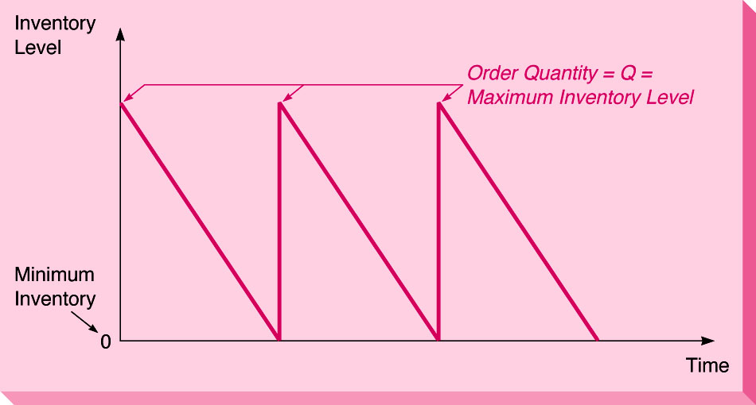
Inventory Usage Over Time - Fig. 6.2
Sawtooth Inventory Curve

Slide 15
Costs as Functions of Order Quantity - Fig. 6.3
View #1
Annual
Cost
Total Cost Curve
Carrying (holding)
Cost Curve
Minimum Cost
Ordering (set-up)
Cost Curve
Q*
Order Quantity

Slide 16
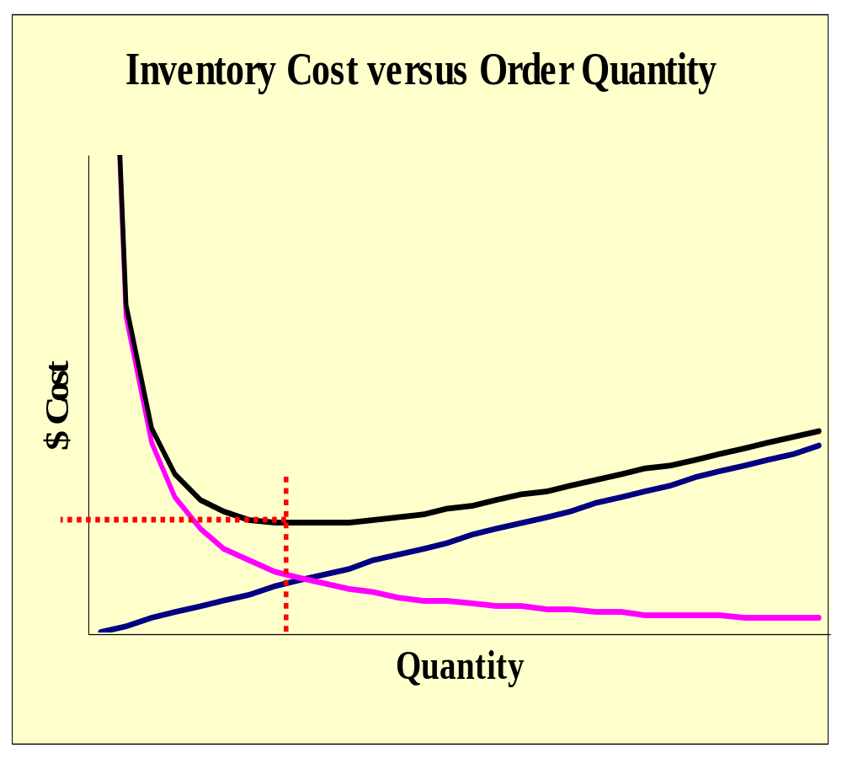
Costs as Functions of Order Quantity - Fig. 6.3
View #2
Total Cost
Minimum Cost
Carry Cost
Order Cost
Optimal Quantity

Slide 17
EOQ : Basic Assumptions
Demand is known and constant.
Lead time is known and constant.
Receipt of inventory is instantaneous.
Quantity discounts are not possible.
The only variable costs: set-up or placing an order, and holding or storing inventory over time.
Stockouts can be completely avoided if orders are placed at the appropriate time.

Slide 18
Steps in Finding the Optimum Inventory
Develop an expression for the ordering cost.
Develop and expression for the carrying cost.
Set the ordering cost equal to the carrying cost.
Solve this equation for the optimal order quantity, Q*.

Slide 19
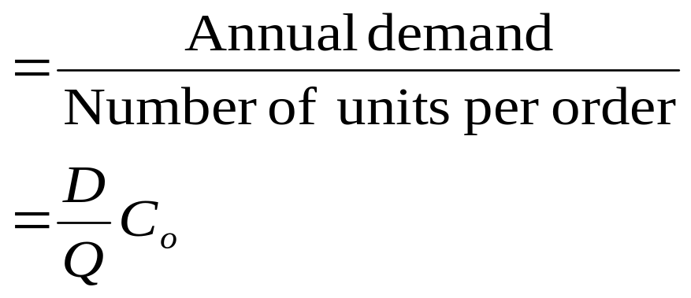
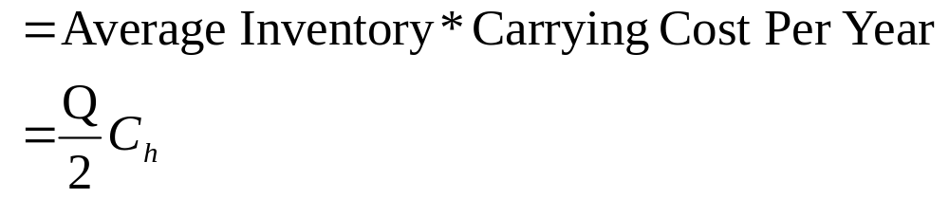
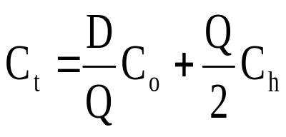
Developing the EOQ
Annual ordering cost:
Annual holding or carrying cost:
Total inventory cost:

Slide 20
Setting the Equations Equal to Solve for Q*
D
Q
C
=
C
+
C
t
Q
o
2
h
D
Q
C
=
C
Q
o
2
h
Q²
=
2
D
C
o
C
h
Q*
=
2
D
C
o
C
h

Slide 21
Per Unit vs. Percentage Carrying Cost
Typically, carrying cost, C_{h}, is stated in
  per unit $ cost
  per year
Sometimes, an annual Interest rate, I, is cited and C_{h} must be calculated
  I multiplied by C (unit cost)
IC then replaces C_{h}

Slide 22
EOQ
Per Unit Carrying Cost:
*
=
2DC
o
Q
C
h
Percentage Carrying Cost:
Denominator Change
*
2DC
o
Q
=
IC

Slide 23
Inputs and Outputs of the EOQ Model
Input Values
Output Values
Economic Order
Quantity (EOQ)
Annual Demand
(D)
Avg. Inventory (Q/2)
Ordering Cost
(C_{o})
Carrying Cost
(C_{h})
EOQ
Models
# of Orders
(D/Q)
Lead Time
(L)
Cycle Time (Q/D*360)
Demand Per Day
(d)
Reorder Point
(ROP)

Slide 24
The Reorder Point (ROP) Curve - Fig. 6.4
ROP = (Demand per day) x (Lead time for a new order, in days) = d x L
Q*
Slope = Units/Day = d
ROP
(Units)
Inventory Level (Units)
Lead Time (Days)
L

Slide 25
Inventory Control and the Production Process
Suspension of the
Instantaneous Receipt Assumption
Production Portion of Cycle (t) = Q/p
Q*
Maximum Inventory
Level
Inventory Level
Demand
Portion
of Cycle
Demand
Portion
of Cycle
Time
Production Run Model Figure 6.5

Slide 26
Production Quantity EOQ
Annual Carrying Cost:
Annual Setup or Ordering Cost:
  Setup Cost:
  Ordering Costs:
Q
d
(
1
−
)
C
2
p
h
D
C
s
Q
D
C
Q
o

Slide 27
Production Quantity EOQ
2DC
*
=
Q
s
p
⎛
_
d
⎞
C
⎜
1
⎟
h
⎜
p
⎟
⎝
⎠
If production is not the cause of delayed receipts, use the same model but replace C_{s} with C_{o}

Slide 28
Brown Manufacturing Example
Annual demand (D) = 10,000 units
Setup cost (Cs) = $100
Carrying cost (Ch) = $0.50 per unit per year
Production rate (p) = 80 units daily
Demand rate (d) = 60 units daily
Refrigeration operational days = 167 days per year

Slide 29
Brown Manufacturing Example continued
How many refrigeration units should Brown produce in each batch?
  i.e., What is Q_{p}*?
How long should the production cycle last ?
  i.e., What is Q/p?

Slide 30
Brown Manufacturing Example continued
What is Q_{p}*?
2DC
*
=
Q
s
p
⎛
_
d
⎞
C
⎜
1
⎟
h
⎜
p
⎟
⎝
⎠
2(10,000)(100)
*
=
Q
p
⎛
60
_
⎞
(0.5)
⎜
1
⎟
⎜
⎟
80
⎝
⎠
*
=
4,000 units
Q
p

Slide 31
Brown Manufacturing Example continued
How long should the production cycle last ? What is t (Q/p)?
*
=
4,000 units
Q
p
p = 80 units per day
t = Q/p = 4,000/80 = 50 days
Production runs will cover 50 days and produce 4,000 units

Slide 32
Quantity Discount Models
Object is to Minimize total inventory costs; includes material costs
Material costs relevant in total cost:
  TC = DC + D/Q(C_{o}) + Q/2(C_{h})
  where
  D = unit annual demand
  C = unit cost
  C_{o} = each order cost
  C_{h} = carrying cost per unit per year
  IC must be used in place of C_{h} in decision-making

Slide 33
Steps for Solving Quantity Discount
Compute EOQ for each discount price:
If EOQ < discount minimum level, make Q = minimum.
For each EOQ, compute total cost:
  TC = DC + D/Q(C_{o}) + Q/2(C_{h})
Choose the lowest cost quantity from all levels.
*
2DC
o
Q
=
IC

Slide 34
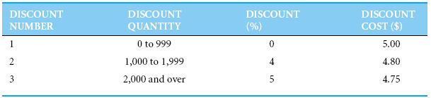
Quantity Discount Models – Table 6.3
Text example:
Quantity Discount Schedule
Table 6.3
Material cost:
  Total material cost is affected by the
  Discount (%)
  Unit cost if first $5.00, then $4.80,
  and finally $4.75

Slide 35
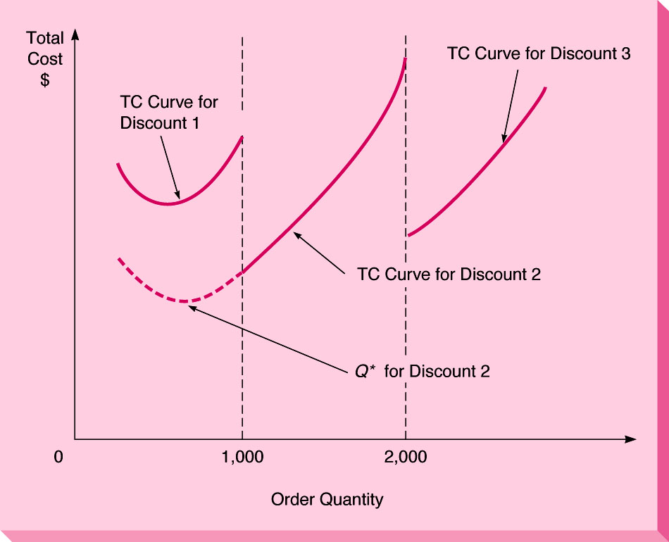
Quantity Discount Models - Fig. 6.6
Total Cost Curves for each of the 3 discount plans
Figure 6.6

Slide 36
Quantity Discount Steps – A Review
1. Calculate Q for each discount.
2. Adjust Q upward if quantity is too low for discount.
3. Compute total cost for each discount.
4. Select Q with the the lowest total cost.

Slide 37
The Use of Safety Stock
Stockouts occur when there are uncertainties with:
  Demand
  Lead time
Safety stock is extra stock on hand to avoid stockouts
ROP is adjusted to implement safety stock policy:
ROP = d*L + SS
d = average daily demand
L = average lead time, time for an order to be delivered
SS = safety stock

Slide 38
The Use of Safety Stock
Fig. 6.7
Inventory on
Hand
0
Time
Stockout
Inventory on
Hand
Safety Stock
Stockout
is avoided
0
Time

Slide 39
The Use of Safety Stock and ROP
Known stockout costs:
  Given probability of demand, find total cost for each safety stock alternative
Unknown stockout costs:
  Set service level; use normal distribution

Slide 40
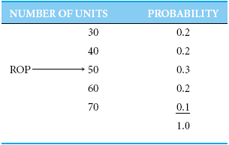
Known Stockout Costs
ABCO example:
Table 6.5
Initial calculations:
ROP = 50 (d*L)
C_{h} = $5
C_{ss} = $40/ unit (stockout cost)
D/Q = 6 times per year

Slide 41
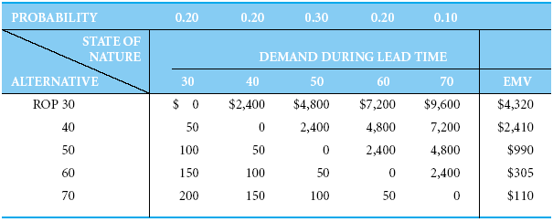
Known Stockout Costs continued
ABCO example:
Table 6.6
Calculation the EMV (expected monetary value) for each ROP alternative

Slide 42
Known Stockout Costs continued
ABCO example:
Calculations for a given ROP, N:
Being Short: D(S) = (N-S)* C_{ss} *D/Q,
  where S = demand during lead time
Being Over: D(O) = (D-O)* C_{h}
  where O = demand under ROP
Calculations for an ROP of 40:
Being Over
D(30) = (40-30)*$5 = $50
D(40) = $0
Being Short
D(50) = (50-40)*$40*6 = $2,400
D(60) = (60-40)*$40*6 = $4,800
D(70) = (70-40)*$40*6 = $7,200

Slide 43
Known Stockout Costs continued
ABCO example:
Last step for ROP = 40 is to calculate the EMV:
EMV = Σ P(D) * Cost of Being Short/Over
EMV(40) =
0.20*$50 + 0.20*$0 + 0.30*$2,400 +
0.20*$4,800 + 0.10*$7,200 = $2,410

Slide 44
Unknown Stockout Costs
When stockout costs are not quantifiable or not applicable:
  Use a service level to determine safety stock level.
  Service Stock: the % of time an item is out of stock.
  Service Level = 1 – P(Stockout)
  Or
  P(Stockout) = 1 – Service Level

Slide 45
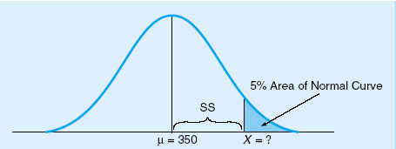
Unknown Stockout Costs continued
Hinsdale Company example:
Lead time demand ~N(350, 10)
  where μ = 350, σ = 10
Desired Policy:
  P(Stockout) = 5%
  Therefore, service level = 95%
  Visualization of Desired Inventory Policy:
Figure 6.9

Slide 46
Unknown Stockout Costs continued
Hinsdale Company example:
X = μ + Safety Stock (SS)
SS = X – μ = Zσ
Z = =
Figure 6.9
X-μ
SS
σ
σ

Slide 47
Unknown Stockout Costs continued
Hinsdale Company example:
Find Z using a Normal table, like in Appendix A:
Z = 1.65 for a 5% right tail
Rewrite equation:
Z = 1.65 = =
Solving for SS yields 16.5, or 17, units.
Therefore, ROP = 350 + 17 = 367
SS
SS
σ
10

Slide 48
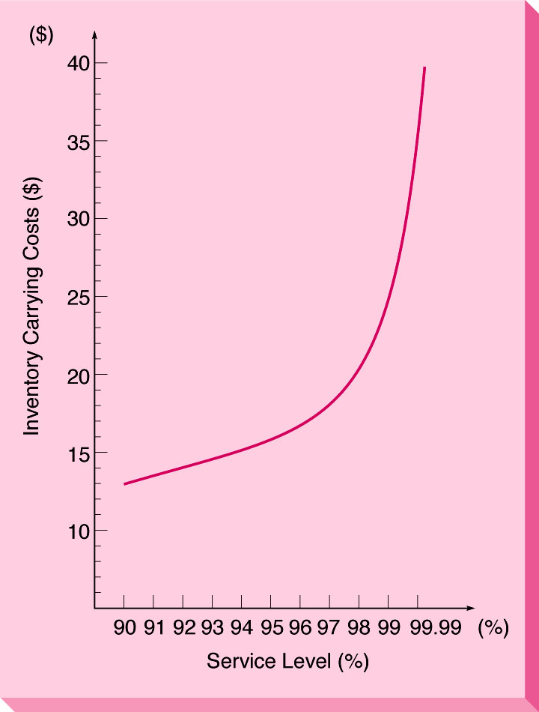
Service Level versus Carrying Costs
The following curve depicts the tradeoff
between carrying costs and service level for
the previous example
such dramatic tradeoffs exist for all similar problems
Figure 6.10

Slide 49
Summary of ABC Analysis Table 6.6
Group A Items - Critical
Group B Items - Important
Group C Items - Not That Important
Are Complex
Quantitative Control
Techniques Used?
Inventory
Group
Dollar
Usage (%)
Inventory
Items (%)
A
B
C
70
20
10
10
20
70
Yes
In some cases
No

Slide 50
ABC Inventory Analysis
100
90
80
70
60
50
40
30
20
10
0
A
Items
Percent of Annual
Dollar Usage
B Items
C Items
1 2 3 4 5 6 7 8 9 10
Percent of Inventory Items

Slide 51
ABC Inventory Policies
Greater expenditure on supplier development for A items than for B items or C items
Tighter physical control on A items than on B items or on C items
Greater expenditure on forecasting A items than on B items or on C items

Slide 52
Inventory for Dependent Demand
Discussion thus far has concerned independent demands
  i.e., demand of one item not dependent on another
Interrelated inventory items means that the demand of one item is dependent on the demand of another
  e.g., demand of lawn mower wheels are dependant on the demand of lawn mowers.

Slide 53
Dependent demand Inventory: MRP
For independent demand inventory, major questions are:
    How much to order
    When to order
On the other hand, dependent demand inventory can be very complex and MRP (material requirements planning) can be employed very effectively.

Slide 54
Benefits of MRP
Increased customer service and satisfaction
Reduced inventory costs
Better inventory planning and scheduling
Higher total sales
Faster response to market changes and shifts
Reduced inventory levels without reduced customer service
Although most MRP systems are computerized, the analysis is straightforward and similar from one computerized system to the next.

Slide 55
MRP: Typical Procedures
Develop a BOM (bill of materials)
The BOM identifies
  The components
  Component descriptions
  Amount required to produce 1 unit of final product
Develop a Material Structure Tree
  The tree has several levels depending on the depth of subcomponent required
  Parents and components are identified
    Items above any level are parents
    Items below any level are components
  The tree shows how many units are needed at each level of production

Slide 56
Material Structure Tree:
An Example
Assume demand for product A is 50 units
Each unit of A requires
  2 units of B, which in turn requires
    1. 2 units of D
    2. 3 units of E
  3 units of C, which in turn requires
    1. 1 unit of E
    2. 2 units of F

Slide 57
Material Structure Tree:
An Example continued
This structure tree has 3 levels:
  0, 1, and 2
There are 3 parents:
  A, B, C
There are 5 components:
  B, C, D, E, F
B and C are parents and components
Material Structure Tree is on next slide
Numbers in parentheses next to the levels indicate the amounts needed for 1 unit of final product of A
For example, B(2) indicates that it takes 2 units of B to make 1 unit of A

Slide 58
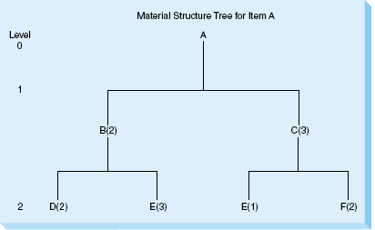
Material Structure Tree An Example continued
Figure 6.11
After developing the tree, the number of units
of each item needed to satisfy demand can be
calculated. This is shown on the next slide.

Slide 59
Material Structure Tree An Example continued
Component Calculations:
Part B:
2×# of A = 2×50 = 100
Part C:
3×# of A = 3×50 = 150
Part D:
2×# of B = 2×100 = 200
Part E:
3×# of B + 1×# of C = 3×100 + 1×150 = 450
Part F:
2×# of C = 2×150 = 300

Slide 60
Material Structure Tree An Example continued
Thus, for 50 units of A we need 100 units of B, 150 units of C, 200 units of D, 450 units of E, and 300 units of F.
The numbers in this table could also have been determined directly from the material structure tree by multiplying the numbers along the branches times the demand for A, which is 50 units for this problem.
For example, the number of units of D needed is simply 2 × 2 × 50 = 200 units.

Slide 61
Gross Material Requirements Plan
Once the materials structure tree is done, construct a gross material requirements plan.
This is a time schedule that shows when an item must be ordered
  when there is no inventory on hand, or
  when the production of an item must be started in order to satisfy the demand for the finished product at a particular date.

Slide 62
Net Material Requirements Plan
Using
the gross materials requirements plan
and the inventory on-hand information,
a net material requirements plan can be
constructed.
This plan includes
gross requirements,
on-hand inventory,
net requirements,
planned-order receipts, and
planned-order releases
for each item.
The net requirements plan is constructed
like the gross requirements plan.

Slide 63
Just-in-Time (JIT)
Inventory Control
One objective to achieve greater efficiency in the production process has been having less in-process inventory on hand.
JIT inventory achieves this objective:
  inventory arrives just-in-time to be used during the production process to produce subparts, assemblies, or finished goods.
One technique of implementing JIT is a manual procedure called kanban.
  Kanban in Japanese means “card.”
With a dual-card kanban system, there is
  a conveyance kanban, or C-kanban, and
  a production kanban, or P-kanban.

Slide 64
4 Steps of Kanban
The kanban system is very simple.
These are the steps:
A worker takes a container of parts or inventory along with its C-kanban to his or her work area.
  When there are no more parts or the container is empty, the user returns the empty container along with the C-kanban to the producer area.

Slide 65
4 Steps of Kanban continued
At the producer area, there is a full container of parts along with a P-kanban.
  The user detaches the P-kanban from the full container of parts.
  Then the user takes the full container of parts along with the original C-kanban back to his or her area for immediate use.

Slide 66
4 Steps of Kanban continued
The detached P-kanban goes back to the producer area along with the empty container.
  The P-kanban is a signal that new parts are to be manufactured or that new parts are to be placed into the container.
  When the container is filled, the P-kanban is attached to the container.

Slide 67
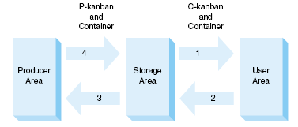
4 Steps of kanban continued
This process repeats itself during the typical workday.
  The dual-card kanban system is shown below (Figure 6.15)

Slide 68
ENTERPRISE RESOURCE PLANNING
MRP evolved to include
  not only the materials required in production, but also
  the labor hours, material cost, and other resources related to production.
In this approach
  the term MRP II is often used, and
  the word resource replaces the word requirements.
As this concept evolved and sophisticated software was developed, these systems became known as
  enterprise resource planning (ERP) systems.

Slide 69
ENTERPRISE RESOURCE PLANNING continued
Objective of an ERP System
  to reduce costs by integrating all of the operations of a firm.
  starts with the supplier of needed materials, flows through the organization, includes invoicing the customer of the final product.
Once data enters database, it can be quickly and easily accessed by anyone.
This benefits
  the functions related to planning and managing inventory, but also
  other business processes such as accounting, finance, and human resources.

Slide 70
ENTERPRISE RESOURCE PLANNING continued
The benefits of an ERP system are
  reduced transaction costs and
  increased speed and accuracy of information.
There are drawbacks
  The software is expensive to buy and costly to customize.
  The implementation of an ERP system may require a company to change its normal operations.
  Employees are often resistant to change.
  Training employees on the use of the new software can be expensive.

Slide 71
ENTERPRISE RESOURCE PLANNING continued
Many ERP systems are available.
The most common ones are from the firms
  SAP,
  Oracle,
  People Soft,
  Baan, and
  JD Edwards.
Even small systems can cost hundreds of thousands of dollars.
The larger systems can cost hundreds of millions of dollars.

